Slide 1

📊 Procurement Analytics Dashboard – 2022

Slide 2

Project Overview
This project delivers a comprehensive procurement data analysis using Excel and Power Query. The goal is to transform raw purchase order data into actionable insights through an interactive dashboard, enabling better vendor, product, and inventory decisions.
5000
2523
Purchase Orders
Received
Total orders processed
Orders successfully delivered
2477
Pending
Orders awaiting fulfillment

Slide 3


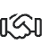


Project Objective
To help stakeholders monitor procurement activities efficiently by:
Identifying trends in purchases by quantity and amount
Evaluating vendor performance
Tracking inventory movements and balances
Supporting data-backed decision-making for supply chain management

Slide 4
Tasks Performed
Data Preparation
Data Modeling
Dashboard Design
Cleaned and transformed raw purchase order data using Power Query
Built relationships across vendor, product, and date dimensions
Built interactive charts using PivotTables and slicers
Created calculated columns and KPIs
Designed slicers for filters (Status, Month, Product, Vendor)
Standardized date formats, filled missing values, and corrected inconsistencies
Created summary cards for totals (POs, Vendors, Status)

Slide 5
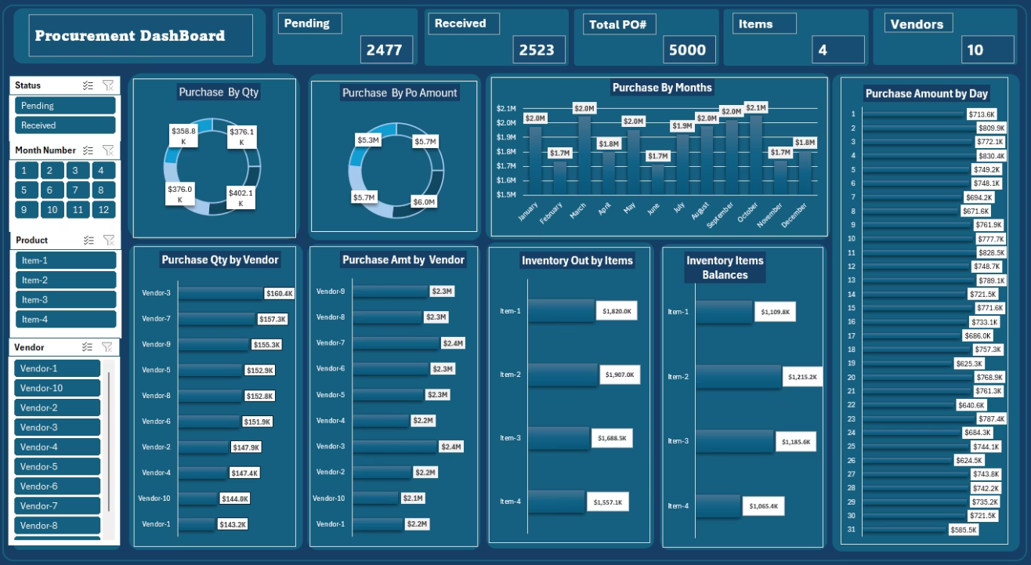
Dashboard

Slide 6

How to Use the Dashboard
Apply Filters
Use slicers (Status, Month Number, Product, Vendor) to filter views
Review Summary Metrics
Top Panels: Show totals for Pending, Received, Total PO#, Items, Vendors
Analyze Distributions
Pie Charts: Visualize purchase quantity and amount distribution
Examine Detailed Trends
Bar Charts: Track purchases by month and day, evaluate vendor-wise purchase performance, monitor inventory outflows and current item balances

Slide 7





Key Insights
Purchase Orders
Total Purchase Orders: 5000, with 2523 Received and 2477 Pending
Peak Periods
Highest purchase volume occurred in September and October
Top Vendors
Vendor-7 and Vendor-8 show the strongest procurement values
Inventory Movement
Item-2 had the highest inventory outflow, while Item-1 retained higher balances
Peak Days
Specific dates like Day 2, 5, and 7 had peak purchase amounts

Slide 8

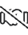




Strategic Recommendations for Supply Chain Optimization
Vendor Performance Optimization
Focus on top performers
Inventory Planning
Align with high-volume periods
Efficiency in PO Cycle
Address pending orders
Vendor Performance Optimization: Focus future negotiations with top-performing vendors (e.g., Vendor-7, Vendor-8). Reassess engagement with low-contributing vendors.
Inventory Planning: Align purchasing schedules with high-volume months. Monitor items with low balance for restocking alerts.
Efficiency in PO Cycle: Address pending POs with Vendor-1 and Vendor-3 to improve fulfillment timelines.

Slide 9








Conclusion
Transparency
Insights
Unified view of procurement
Vendor and inventory analytics
Strategy
Planning
Enhanced procurement decisions
Proactive supply management
This procurement dashboard empowers decision-makers with a unified view of purchase order activity, vendor efficiency, and inventory health. It improves transparency, supports proactive planning, and enhances overall procurement strategy.

Slide 10



Thank You
Presented by
Dharmesh Parmar
Contact
dhparmar2119@gmail.com
Questions?
Happy to provide additional insights

